Slide 1
Introduction to Graphs
GRAPH ALGORITHMS
INTRODUCTION

Slide 2
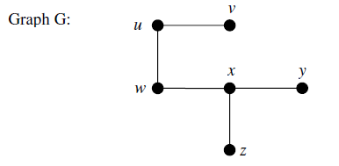
Graph Terminologies
A graph G = (V, E) consists of a set of objects V={v1, v2, v3, … } called vertices (also called points or nodes) and other set E = {e1, e2, e3, .......} whose elements are called edges (also called lines or arcs).
A graph G is defined by the sets V(G) = {u, v, w, x, y, z} and
E(G) = {uv, uw, wx, xy, xz}.

Slide 3
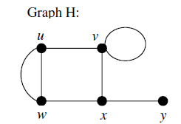
Graph Terminologies
A graph G is defined by the sets V(G) = {u, v, w, x, y, z} and
E(G) = {uv, uw, wx, xy, xz}.
The set V(G) is called the vertex set of G and E(G) is the edge set of G.
A graph with p-vertices and q-edges is called a (p, q) graph.
The (1, 0) graph is called trivial graph.
An edge having the same vertex as its end vertices is called a self-loop.
More than one edge associated a given pair of vertices called parallel edges.
Intersection of any two edges is not a vertex.

Slide 4
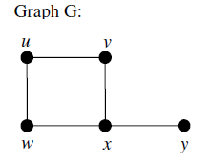
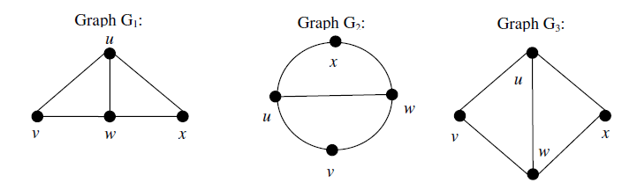
Graph Terminologies
A graph that has neither self-loops nor parallel edges is called simple graph.
Same graph can be drawn in different ways.
A graph is also called a linear complex, a 1-complex, or a one-dimensional complex.
A vertex is also referred to as a node, a junction, a point, O-cell, or an O-simplex.
Other terms used for an edge are a branch, a line, an element, a 1-cell, an arc, and a 1-simplex.

Slide 5
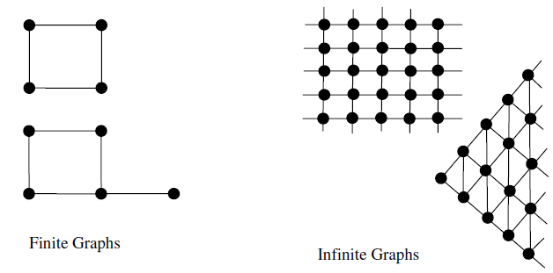
Graph Terminologies
Finite and infinite graphs
A graph with a finite number off vertices as well as a finite number of edges is called a finite graph; otherwise, it is an infinite graph.

Slide 6
Graph Terminologies
ADJACENT: (VERTICES)
For a Graph G (V,E), two vertices (x,y) є V are said to be adjacent if they are connected by an edge.
(x,y) є V so {x, y} є E
INCIDENSE: (VERTEX/EDGE)
For a Graph G (V,E), two vertices (x,y) є V connected with an edge {x, y} are said to be incident to that edge
Edge {x, y} є E is incident to x & y
2 vertices are adjacent if connected by an edge
2 edges are incident if they share a vertex
2 non-parallel edges are said to be adjacent if they are incident on a common vertex
a vertex and an edge are called incident, if vertex is one of 2 vertices the edge connect

Slide 7
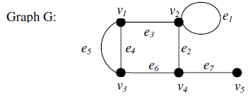
Graph Terminologies
DEGREE: (VERTICES)
Degree of a vertex of a graph is the number of edges that are incident to the vertex.
Self loop are counted twice.
d(v1) = d(v3) = d(v4) = 3. d(v2) = 4. d(v5) = 1.
Total degree = d(v1) + d(v2) + d(v3) + d(v4) + d(v5)
= 3 + 4 + 3 + 3 + 1 = 14 = Twice the number of edges.

Slide 8
Graph Terminologies
Incidence, adjacent and degree
When a vertex vi is an end vertex of some edge ej, vi and ej are said to be incident with each other.
Two non parallel edges are said to be adjacent if they are incident on a common vertex.
The number of edges incident on a vertex vi, with self-loops counted twice, is called the degree (also called valency), d(vi), of the vertex vi.
A graph in which all vertices are of equal degree is called regular graph.

Slide 9
Graph Terminologies
Incidence, adjacent and degree
The edges e2, e6 and e7 are incident with vertex v4.
The edges e2 and e7 are adjacent.
The edges e2 and e4 are not adjacent.
The vertices v4 and v5 are adjacent.
The vertices v1 and v5 are not adjacent.
d(v1) = d(v3) = d(v4) = 3. d(v2) = 4. d(v5) = 1.
Total degree = d(v1) + d(v2) + d(v3) + d(v4) + d(v5)
= 3 + 4 + 3 + 3 + 1 = 14 = Twice the number of edges.
Theorem
The number of vertices of odd degree in a graph is always even.

Slide 10
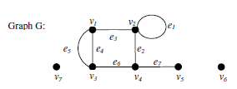
Graph Terminologies
Isolated Vertex
A vertex having no incident edge is called an isolated vertex.
Isolated vertices are vertices with zero degree
The vertices v6 and v7 are isolated vertices.
Pendant Vertex
A vertex of degree one is called a pendant vertex or an end vertex.
The vertex v5 is a pendant vertex.

Slide 11


Graph Terminologies
Null Graph
In a graph G=(V, E), If E is empty (Graph without any edges), then G is called a null graph.
Multi Graph
A graph in which no loops are allowed but more than one edge can join two vertices, these edges are called multiple edges or parallel edges and a graph is called multigraph.

Slide 12
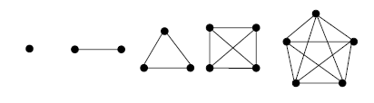
Graph Terminologies
Complete Graph
A simple graph G is said to be complete if every vertex in G is connected with every other vertex. i.e., if G contains exactly one edge between each pair of distinct vertices.
A complete graph is usually denoted by Kn. It should be noted that Kn has exactly n(n-1)/2 edges.
The complete graphs Kn for n = 1, 2, 3, 4, 5 are:

Slide 13
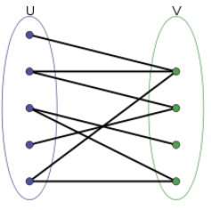
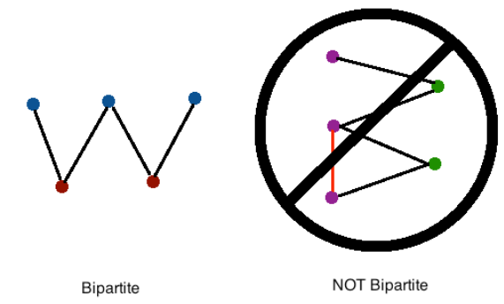
Graph Terminologies
Complete Bipartite Graph
Bipartite Graph:
A graph whose vertices can be divided into two disjoint
& independent sets.
A graph G=(V(G),E(G)) is said to be Bipartite if and only if there exists a partition V(G)=A∪B and A∩B=∅.
Hence all edges share a vertex from both set A and B, and there are no edges formed between two vertices in the set A, and there are not edges formed between the two vertices in B.

Slide 14
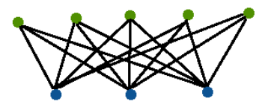
Graph Terminologies
COMPLETE BIPARTITE GRAPH:
Complete bipartite graph Km,n has a vertex set, the disjoint union of a set V1 with m elements and a set V2 with n elements, edges are all the sets {a, b} with a from V1 & b from V2
A graph G = (V(G), E(G)) is said to be Complete Bipartite if and only if there exists a partition V(G)=A∪B and A∩B=∅ so that all edges share a vertex from both set A and B and all possible edges that join vertices from set A to set B are drawn.
We denote a complete bipartite graph as Kr,s where r refers to the number of vertices in subset A and s refers to the number of vertices in subset B. Below is an example of the complete bipartite graph K5,3:

Slide 15
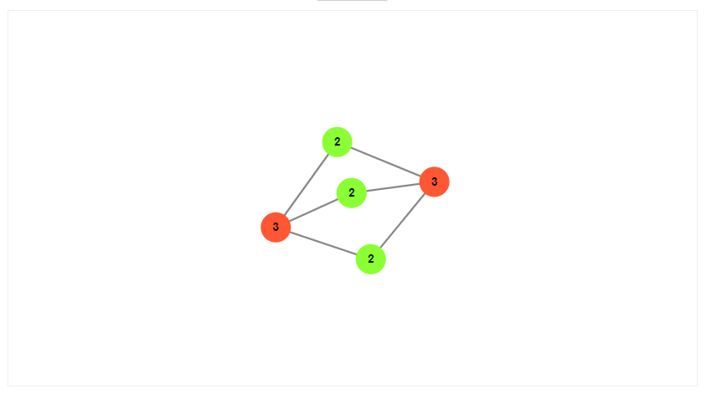

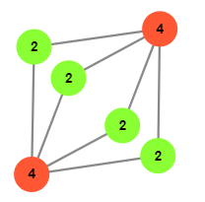

Graph Terminologies
COMPLETE BIPARTITE GRAPH:
EXPLORE:
https://d3gt.com/unit.html?complete-bipartite

Slide 16
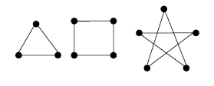
Graph Terminologies
Regular Graph
A graph, in which all vertices are of equal degree, is called a regular graph.
If the degree of each vertex is r, then the graph is called a regular graph of degree r.

Slide 17
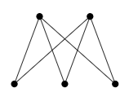
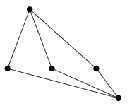
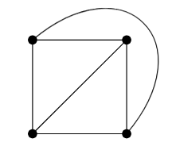
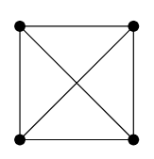
Graph Terminologies
Planar Graph
When a connected graph can be drawn without any edge crossings, graph is known as a Planer graph.
When a planer graph is drawn, it divides the planes into regions called faces

Slide 18
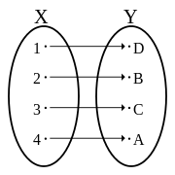
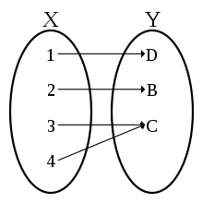
Graph Terminologies
ISOMORPHISM
A graph can exist in different forms having the same number of vertices, edges, and also the same edge connectivity. Such graphs are called isomorphic graphs.
Two graphs G₁ and G₂ are said to be isomorphic to each other if there is bijection between their vertices and between their edges such that the incidence relationship is preserved.
One-To-One Function (Injective):
Function f is one to one if f maps every element of
X to a unique element in Y.
Onto Function (Surjective):
Function f is onto if every element of Y is mapped by
some element of X
FUNCTION f is BIJECTIVE, if it is one-to-one and onto

Slide 19
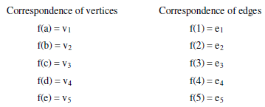
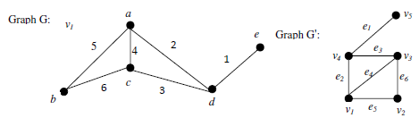
Graph Terminologies
ISOMORPHISM
Two graphs G₁ and G₂ are said to be isomorphic if
Their number of components (vertices and edges) are same
Their edge connectivity is retained
If G₁ ≡ G₂ then
|V(G₁)| = |V(G₂)|
|E(G₁)| = |E(G₂)|
Degree sequences of G₁ and G₂ are same
(To check the graphs isomorphism, check the adjacency matrix of both graphs)
Adjacency also preserved. Therefore G and G' are said to be isomorphic.

Slide 20
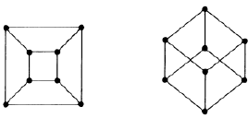
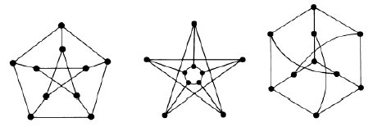
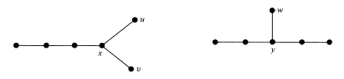
Graph Terminologies
ISOMORPHISM

Slide 21

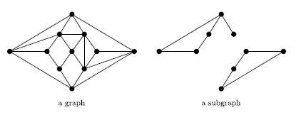
Graph Terminologies
SUB GRAPHS
A graph G' is said to be a subgraph of a graph G, if all the vertices and all the edges of G' are in G, and each edge of G' has the same end vertices in G' as in G.
Each graph of the form (V',E') where V'⊂ V and E'⊂ E|V' is said to be a subgraph of G,

Slide 22
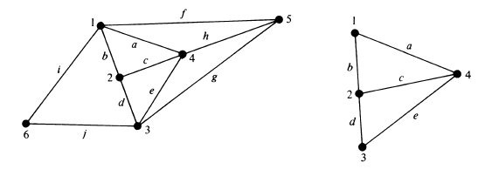
Graph Terminologies
SUB GRAPHS
A subgraph can be thought of as being contained in (or a part of) another graph. The symbol from set theory, g ⊂ G, is used in stating "g is a subgraph of G".
The following points are valid for subgraphs:
Every graph is its own subgraph.
A subgraph of a subgraph of G is a subgraph of G.
A single vertex in a graph G is a subgraph of G.
A single edge in G, together with its end vertices, is also a subgraph of G.

Slide 23
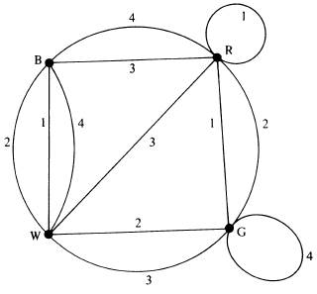
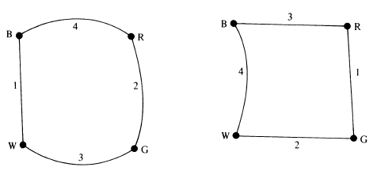
Graph Terminologies
EDGE-DISJOINT SUBGRAPHS
Two (or more) subgraphs g₁ and g₂ of a graph G are said to be edge disjoint if g₁ and g₂ do not have any edges in common.
Edge-disjoint graphs do not have any edge in common, they may have vertices in common.
Sub-graphs that do not even have vertices in common are said to be vertex disjoint.

Slide 24
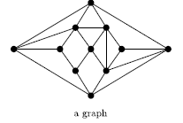
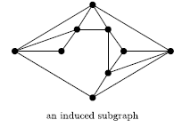
Graph Terminologies
INDUCED SUB GRAPHS
Let G = (V,E) be a graph:
V’ be a subset of V
E|V’ be the set of all edges e ∈ E which have both the vertices in V’
The graph (V’,E|V’) is called the induced subgraph on V’ and is denoted by G|V’

Slide 25
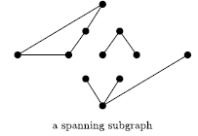
Graph Terminologies
SPANNING SUB GRAPHS
Let G = (V,E) be a graph:
A subgraph with V’= V is called a spanning subgraph.

Slide 26
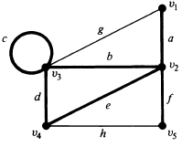
Graph Terminologies
WALKS, PATHS and CIRCUITS
WALK
A walk is defined as a finite alternating sequence of vertices and edges, beginning and ending with vertices.
No edge appears more than once in a walk.
A vertex, however, may appear more than once.
A walk is referred to as an edge chain.
The set of vertices and edges constituting a given walk in a graph G is a subgraph of G
v1 a v2 b v3 c v3 d v4 e v2 f v5
is a walk

Slide 27
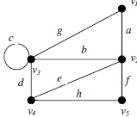
Graph Terminologies
WALKS, PATHS and CIRCUITS
WALK
Vertices with which a walk Begins and Ends are called Terminal Vertices.
CLOSED WALK:
A walk that begin and end at the same vertex is called closed walk.
OPEN WALK:
A walk that have distinct terminal vertices is called opened walk.
v1 a v2 b v3 c v3 is a open walk
v1 a v2 b v3 g v1 is a closed walk

Slide 28
Graph Terminologies
WALKS, PATHS and CIRCUITS
PATH
An open walk in which no vertex appears more than once is called path (or a simple path or an elementary path).
A path does not intersect with itself.
The number of edges in a path is called length of a path.
Terminal vertices of a path are of degree 1 and the rest of vertices (intermediate vertices) are of degree 2
Self-loop can be included in a WALK but not in a PATH.
v1 a v2 b v3 d v4
is a path
v2 b v3 c v3 d v4 e v2 f v5
is not a path.

Slide 29
Graph Terminologies
WALKS, PATHS and CIRCUITS
CIRCUITS
A closed walk in which no vertex (except the initial and the final vertex) appears more than once is called a circui.
A circuit is a closed, non-intersecting walk
Every vertex in a circuit is of degree 2
Circuit is also called a Cycle, Elementary Cycle, Circular Path
v2 b v3 d v4 e v2
is a circuit.

Slide 30
Graph Terminologies
WALKS, PATHS and CIRCUITS
CIRCUITS
A closed walk in which no vertex (except the initial and the final vertex) appears more than once is called a circuit.
A circuit is a closed, non-intersecting walk
Every vertex in a circuit is of degree 2
Circuit is also called a Cycle, Elementary Cycle, Circular Path
Every self-loop is a circuit
v2 b v3 d v4 e v2
is a circuit.

Slide 31
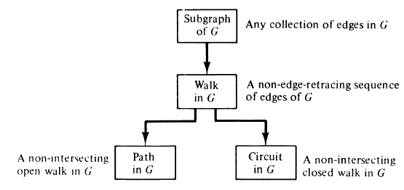
Graph Terminologies
WALKS, PATHS and CIRCUITS
The concepts of a path and a circuit are simple, formal definition can be explained with the following flow chart

Slide 32
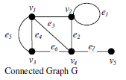
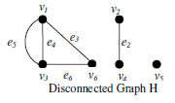
Graph Terminologies
CONNECTEDNESS:
A graph G is said to be connected if there is at least one path between every pair of vertices in G.
Otherwise, G is disconnected.

Slide 33

Graph Terminologies
COMPONENTS:
A disconnected graph consists of two or more connected graphs. Each of these connected subgraphs is called a component.

Slide 34
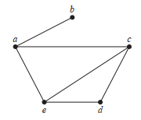
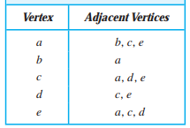
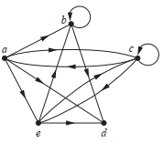
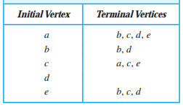
Graph Representation
Adjacency Lists:
A way to represent a graph with no multiple edges is to use adjacency lists, which specify the vertices that are adjacent to each vertex

Slide 35

Graph Representation
Adjacency Matrix:
Graphs can be represented using matrices.
Suppose that G = (V, E) is a simple graph where |V | = n. Suppose that the vertices of G are listed arbitrarily as v₁, v₂, . . . , v_{n}. The adjacency matrix A (or AG) of G, with respect to this listing of the vertices, is the n x n zero–one matrix with 1 as its (i, j)th entry when v_{i} and v_{j} are adjacent, and 0 as its (i, j)th entry when they are not adjacent. In other words, if its adjacency matrix is A = [a_{ij}]

Slide 36
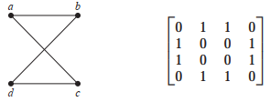
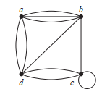

Graph Representation
Adjacency Matrix:

Slide 37

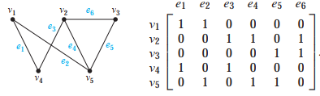
Graph Representation
Incidence Matrix:
Another way to represent graphs is to use incidence matrices.
Let G = (V, E) be an undirected graph.
v₁, v₂, . . . , v_{n} are the vertices and e₁, e₂, . . . , e_{m} are the edges of G. Then the incidence matrix with respect to this ordering of V and E is the n × m matrix M = [m_{ij}], where

Slide 38
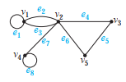
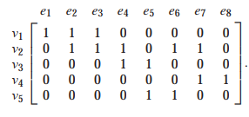
Graph Representation
Incidence Matrix:

